Slide 1

CSE (H) with specialization in Machine Learning and Artificial Intelligence
Soft Computing (CSF – 332)
Chapter -1.3
Neural Network Types
By: Dr. Monika Singh E11032
DISCOVER . LEARN . EMPOWER

Slide 2
Course Objectives
To introduce soft computing concepts and techniques of artificial neural networks, fuzzy sets, fuzzy logic and genetic algorithms
To understand the various techniques from the application point of view.
To analyze various soft computing techniques and decide the technique to be used in a particular problem situation.
To implement soft computing based solutions for real-world problems

Slide 3
Course Outcomes
CO1 | Identify and describe soft computing techniques and their roles in building intelligent. Machines | 1
CO2 | Recognize the feasibility of applying a soft computing methodology for a particular problem. | 2,4
CO3 | Apply fuzzy logic and reasoning to handle uncertainty and solve engineering problems, genetic algorithms to combinatorial optimization problems and neural networks to pattern classification and regression problems. | 3
CO4 | Effectively use modern software tools to solve real problems using a soft computing approach. | 3
CO5 | Evaluate various soft computing approaches for a given problem. | 4

Slide 4
Table of Contents
Neural Network Types
Taxonomy of neural networks
Fully connected layer
Back Propagation

Slide 5
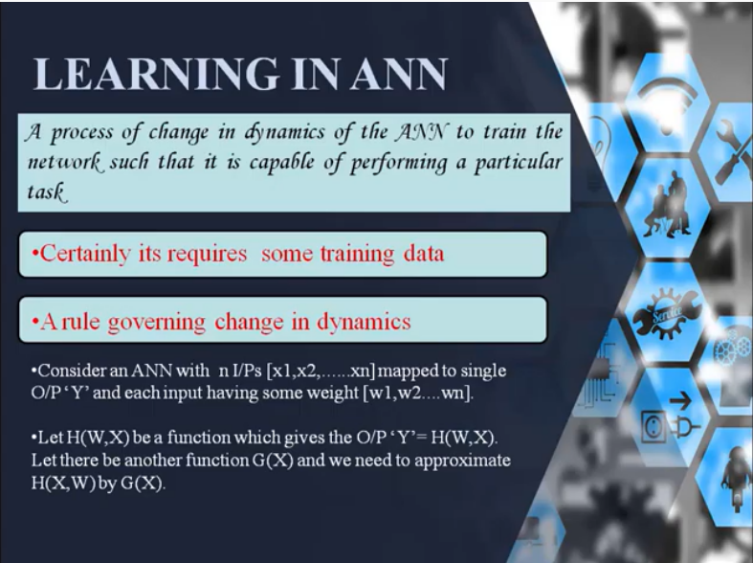

Slide 6
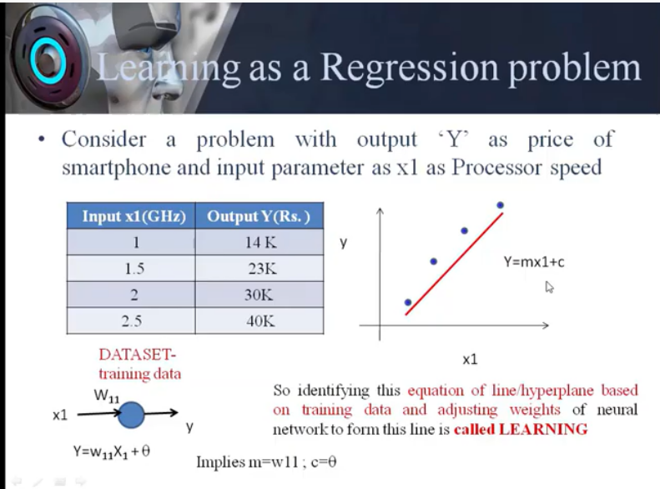

Slide 7
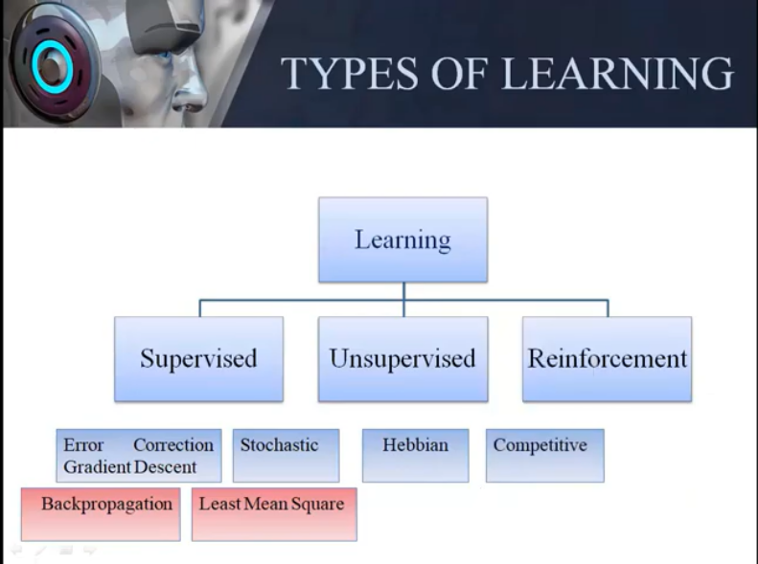

Slide 8
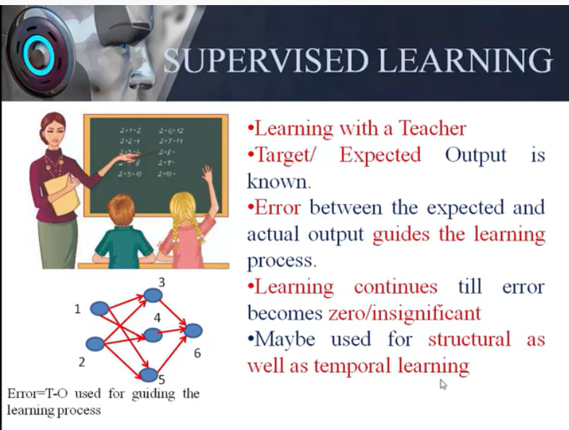

Slide 9
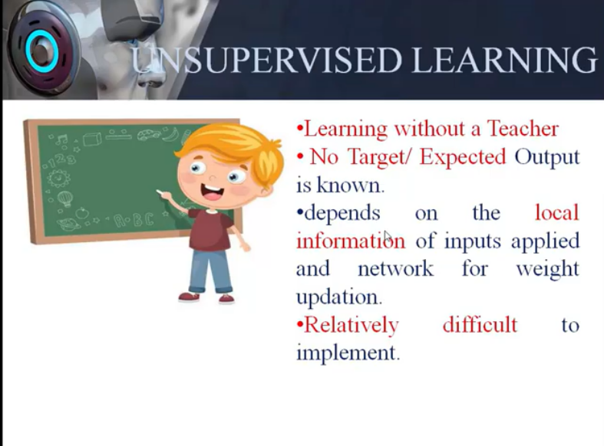

Slide 10
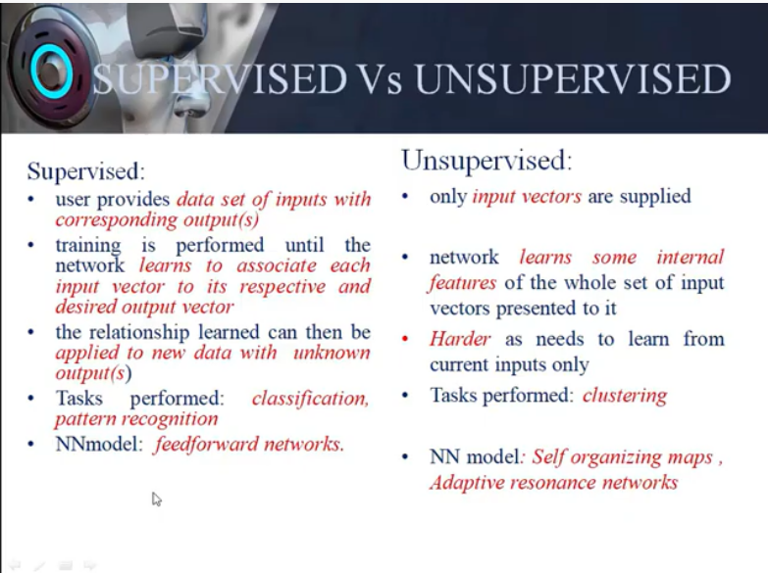

Slide 11
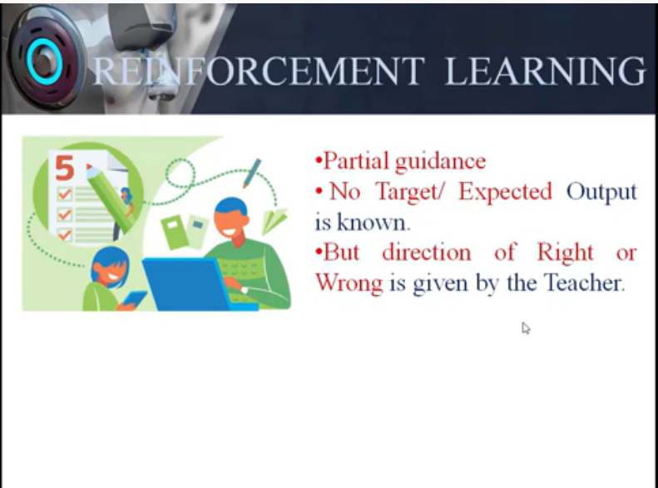

Slide 12
Examples of Supervised Learning
House prices
How’s the weather today?
Is it a cat or a dog?
Who are the unhappy customers?

Slide 13
Examples of Un-Supervised Learning
Finding customer segments
Recommender Systems
Clustering

Slide 14
Examples of Reinforcement Learning
Robotics Manipulation
Self Driving Cars
Chatbots

Slide 15
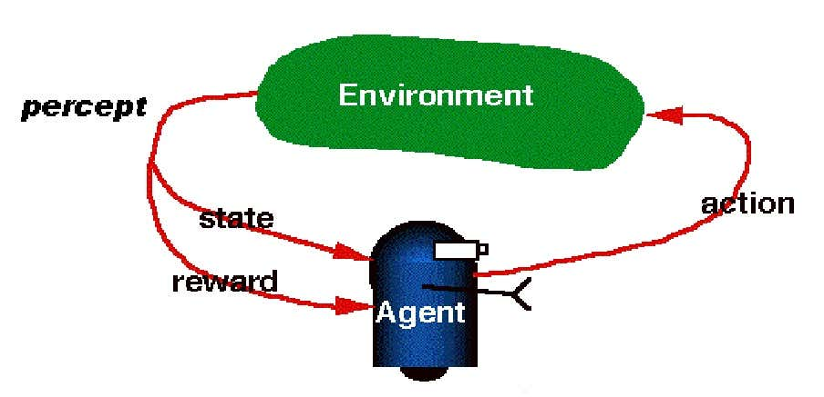
Reinforcement Learning

Slide 16
THANK YOU
For queries
Email: monika.e11032@cumail.in

